Slide 1
Hooking Nirvana
Stealthy Instrumentation techniques
SMART TALKS NOV 2015
ALEX IONESCU
@AIONESCU

Slide 2
WHO AM I?
Chief Architect at CrowdStrike, a security startup
Previously worked at Apple on iOS Core Platform Team
Co-author of Windows Internals 5th and 6th Editions
Reverse engineering NT since 2000 – main kernel developer of ReactOS
Instructor of worldwide Windows Internals classes
Conference speaking:
Recon 2015-2010, 2006
SyScan 2015-2012
NoSuchCon 2014-2013, Breakpoint 2012
Blackhat 2015, 2013, 2008
For more info, see www.alex-ionescu.com

Slide 3
WHAT THIS TALK IS ABOUT
Five different technologies in Windows
Time Travel Debugging / iDNA (Nirvana)
Application Verifier (AVRF)
Minimalized Windows (MinWin)
Application Compatibility Engine (ShimEng)
Control Flow Guard (CFG)
Their intended use in the system
How their use can be misappropriated or leveraged for instrumenting binaries and hooking them early (or late)

Slide 4
PAST RESEARCH
Some of these techniques have partially been exposed before
For example, the Nirvana hook was discovered by Nick Everdox
http://www.codeproject.com/Articles/543542/Windows-x-system-service-hooks-and-advanced-debu
But Windows 10 totally changes the interface…
MinWin has some good information from QuarksLab and ARTeam
http://blog.quarkslab.com/runtime-dll-name-resolution-apisetschema-part-i.html
http://www.xchg.info/wiki/index.php?title=ApiMapSet
But they used manually reverse engineered symbols, and Windows 10 changed them

Slide 5
MORE PAST RESEARCH
CFG has a Whitepaper from TrendMicro, and a presentation from MJ0011
http://sjc1-te-ftp.trendmicro.com/assets/wp/exploring-control-flow-guard-in-windows10.pdf
http://www.powerofcommunity.net/poc2014/mj0011.pdf
But they don’t cover the hooking capabilities
AVRF is a mystery, except to TSS, a Russian Hacker:
http://kitrap08.blogspot.ca/2011/04/application-verifier.html
Not many details
Only one Chinese Forum site talks about the Shim Engine hooks:
http://bbs.pediy.com/showpost.php?p=1199075&postcount=1
Accurate for Windows 8

Slide 6
WINDOWS 10 CHANGES
So we’ll specifically take a look at new changes in Windows 10
New data structures and types
New version numbers
New API parameters/exports/techniques
Semantic/functional changes

Slide 7
OUTLINE
MinWin Hooks
Nirvana Hooks
CFG Hooks
AVRF Hooks
Shim Hooks
QA & Wrap-up

Slide 8
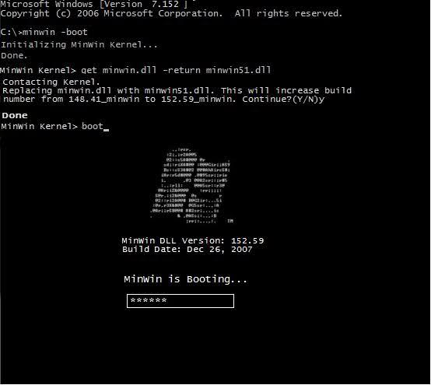
MinWin

Slide 9
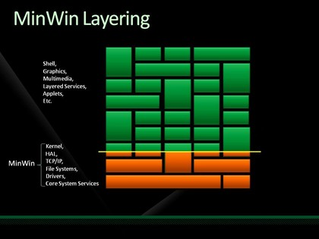
What is MinWin?
MinWin is an internal Microsoft project to re-architect the many layers of the Windows Operating System
Goal is to return to the original layering interface that Dave Cutler wanted – a low-level microkernel, a set of base services, and a subsystem of additional functionality
First “shipped” in Windows 7
People started noticing strange new DLL names as well as import tables
Came in as an “API Contract” mechanism used by user-mode applications
Enhanced in Windows 8
Supported by the kernel and even boot loader
Made “One Core” possible in Windows 10

Slide 10
What are API Sets?
“API Sets are strongly named API contracts that provide architectural separation between an API contract and the associated host (DLL) implementation. API Sets rely on operating system support in the library loader to effectively introduce a namespace redirection component to the library binding process. Subject to various inputs, including the API Set name and the binding (import) context, the library loader performs a runtime redirection of the reference to a target host binary that houses the appropriate implementation of the API Set
The decoupling between implementation and interface contracts provided by API Sets offers many engineering advantages, but can also potentially reduce the number of DLLs loaded in a process.” - Microsoft

Slide 11
API Set Redirection (Win 7)
One single ApiSetSchema.dll file contains the API Set mappings in a PE section called .apiset
Windows kernel, at boot, calls PspInitializeApiSetMap
Verifiers that this is a signed driver image (subject to KMCS)
Finds required PE section
Maps file as PspApiSetMap, stores section as PspApiSetOffset and PspApiSetSize
Each time a process launches, PspMapApiSetView is called
Maps the section using PAGE_READONLY, using the PspApiSetOffset
NOTE: Image is not mapped using SEC_NO_CHANGE nor using MmSecureVirtualMemory
Writes the base address in Peb->ApiSetMap
Loader (Ntdll.dll) parses the API Set during any DLL load operation
LdrpApplyFileNameRedirection

Slide 12
API Set Redirection (Win 7)
Windows 7 included about 35 redirected DLLs
Format of ApiSetMap was documented in apiset.h (Version 2.0)
typedef struct _API_SET_NAMESPACE_ARRAY_V2 { ULONG Version; ULONG Count; API_SET_NAMESPACE_ENTRY_V2 Array[ANYSIZE_ARRAY]; } API_SET_NAMESPACE_ARRAY_V2, *PAPI_SET_NAMESPACE_ARRAY_V2; typedef struct _API_SET_NAMESPACE_ENTRY_V2 { ULONG NameOffset; ULONG NameLength; ULONG DataOffset; } API_SET_NAMESPACE_ENTRY_V2, *PAPI_SET_NAMESPACE_ENTRY_V2;
DLL names include API Set Name (api-ms-win) and Version (LX-X-X)

Slide 13
API Set Redirection (Win 8)
Windows 8 introduces 365 new redirected DLLs
Includes concept of “Extension” Sets, not just “API” Sets
Extensions are used by API Set libraries based on their presence (using ApiSetQueryApiSetPresence) and provide functionality that may exist only on certain operating systems
New loader function: LdrpPreprocessDllName
For example, Kernel Transaction Manager is now an extension in Windows 8, since Windows Phone 8 does not have it
Base library: Tm.sys -> Extension Set: ext-ms-win-ntos-tm-L1-0-0.dll
Now loaded at boot by Winload.exe inside OslLoadApiSetSchema
Additional API Sets can be loaded, and merged into the final schema
Schema written in LoaderBlock->Extension->ApiSetSchema(Size)
MmMapApiSetView now uses SEC_NO_CHANGE

Slide 14
API Set Redirection (Win 8)
Data structures changed to V4 (V3 in Windows 8, V4 in Windows 8.1)
typedef struct _API_SET_NAMESPACE_ARRAY { ULONG Version; ULONG Size; ULONG Flags; ULONG Count; API_SET_NAMESPACE_ENTRY Array[ANYSIZE_ARRAY]; } API_SET_NAMESPACE_ARRAY, *PAPI_SET_NAMESPACE_ARRAY;
typedef struct _API_SET_NAMESPACE_ENTRY { ULONG Flags; ULONG NameOffset; ULONG NameLength; ULONG AliasOffset; ULONG AliasLength; ULONG DataOffset; } API_SET_NAMESPACE_ENTRY, *PAPI_SET_NAMESPACE_ENTRY;

Slide 15
API Set Redirection (Win 10)
Windows 10586 has 641 redirected DLLs (up from 622 in 10240)
Includes all of the support for One Core now
XBOX DLLs
Windows Phone DLLs
Windows IoT DLLs
Windows Server DLLs
Windows Client DLLs
API Structures have changed to V6 Format (breaking change)
Structure is no longer has an array, but rather an offset to the array
Also includes offset to an array of hashes
Then, hash length added to each entry in the array
Aliases replaced by array of names
Will post tool on blog for beer

Slide 16
Special Kernel Base Handling
When the loader (Ntdll.dll) loads kernel base, it also calls LdrpSnapKernelBaseExtensions
This parses all of the delay load descriptors for KernelBase.dll
Looks for any which start with ext-
Finds the API Set Hosts for those extensions, and checks if any resolve to Kernel32.dll
Load them if so, by calling LdrpResolveDelayLoadDescriptor

Slide 17
Parsing Windows 10 API Set
peb = NtCurrentTeb()->ProcessEnvironmentBlock;
ApiSetMap = peb->Reserved9[0]; // ApiSetMap nsEntry = (PAPI_SET_NAMESPACE_ENTRY)(ApiSetMap->EntryOffset + (ULONG_PTR)ApiSetMap);
for (i = 0; i < ApiSetMap->Count; i++) { nameString.Length = (USHORT)nsEntry->NameLength; nameString.Buffer = (PWCHAR)((ULONG_PTR)ApiSetMap + nsEntry->NameOffset);
valueEntry = (PAPI_SET_VALUE_ENTRY)((ULONG_PTR)ApiSetMap + nsEntry->ValueOffset); for (j = 0; j < nsEntry->ValueCount; j++) { valueString.Buffer = (PWCHAR)((ULONG_PTR)ApiSetMap + valueEntry->ValueOffset); valueString.Length = (USHORT)valueEntry->ValueLength; nameString.Length = (USHORT)valueEntry->NameLength; nameString.Buffer = (PWCHAR)((ULONG_PTR)ApiSetMap + valueEntry->NameOffset); valueEntry++; }
nsEntry++; }

Slide 18
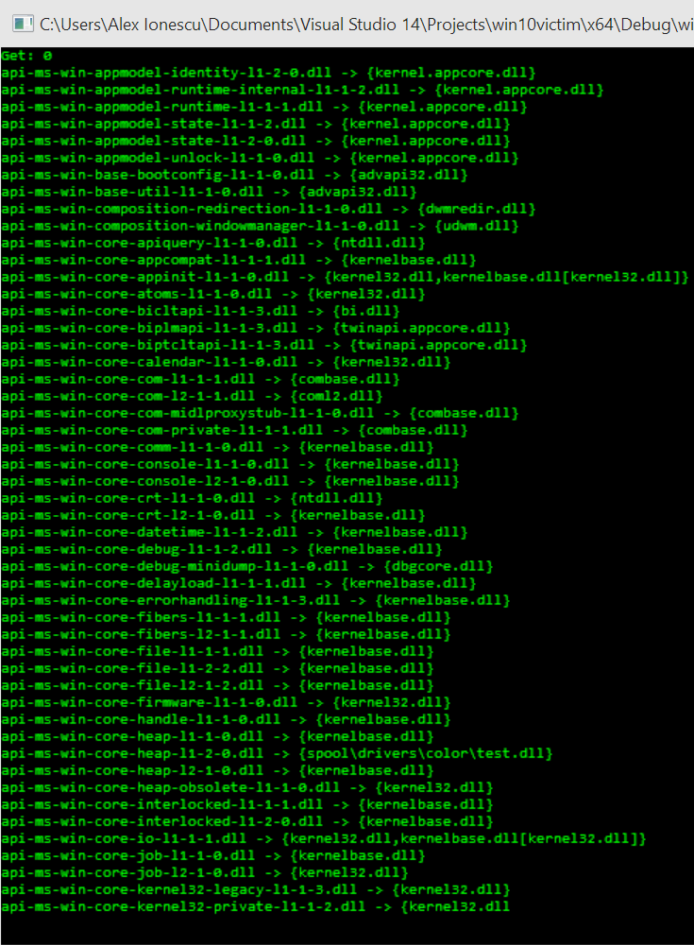
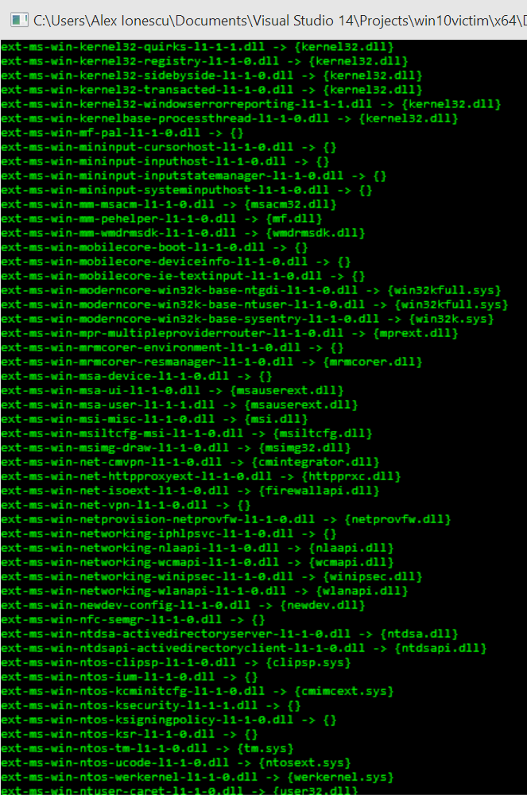
Windows 10 API Sets

Slide 19
Modifying the API Set Map
First, decide which APIs you would like to hook
https://msdn.microsoft.com/en-us/library/windows/desktop/ hh802935(v=vs.85).aspx provides a complete listing of which APIs are in which API Sets
Even undocumented ones are shown!
Parse the API Set Map and locate the API Set Host that contains the API to hook
Replace the string associated with the Value Entry with your own custom DLL
Careful: Value Entry Names are aliased! Changing the *buffer* will redirect multiple API Set Hosts
Instead, allocate additional memory past the end of the API Set Map, and change the offset to your new blob

Slide 20
Gotchas!
API Set Map is mapped as PAGE_READONLY
Windows 8 and higher will not allow VirtualProtect due to SEC_NO_CHANGE
Easier modification: Edit the PEB itself
Steps:
Read existing API Set Map Size
Allocate identical buffer, plus one page
Copy existing API Set Map
Make required changes in the copy, including creating new offsets
Point Peb->ApiSetMap to the copy
Problem #2: All API Set Hosts are assumed to be in %SYSTEMROOT%
Workaround: prefix API Dll Name with “\spool\drivers\color\”
Problem #3: If hook DLL is importing kernel32.dll or advapi32.dll, then these imports will be subject to redirection too, and cause self-redirect
Workaround: Build custom .lib file that points directly to API Set Host

Slide 21
MinWin Hooking Demo

Slide 22
MinWin Bonus
The API Set Schema doesn’t have to be signed by Microsoft ☺
There is a registry key that allows installing custom API Set Schemas ☺
Many parts of the kernel query for “API Set Presence” and optionally call certain add-on/plug-in functions, if present
The right API Set DLL can allow hooking all system calls, process creation/deletion, thread creation/destruction, and more
Sexy persistence mechanism ☺

Slide 23
Double MinWin Bonus
While working on these slides, PowerPoint crashed…
…[MSEC] got the crash dump…
PatchGuard in Windows 10 protects the API Set Map (in kernel-mode) ☺
It’s nice to see Skywing & skape ahead of the bad guys!

Slide 24

Nirvana Hooks

Slide 25
What Is Nirvana?
“Nirvana is a lightweight, dynamic translation framework that can be used to monitor and control the (user mode) execution of a running process without needing to recompile or rebuild any code in that process. This is sometimes also referred to as program shepherding, sandboxing, emulation, or virtualization. Dynamic translation is a powerful complement to existing static analysis and instrumentation techniques.” - Microsoft

Slide 26
Nirvana and iDNA/TTT
Using Nirvana, Microsoft has an internal tool called iDNA, which is also used for Time Travel Tracing (TTT) and TruScan
We keep hearing about these amazing, incredible, Microsoft internal tools in MSR Papers and other conferences
We will never get to use them
How can Nirvana do its job without angering PatchGuard?
In the Windows 7 SDK, Microsoft (accidentally?) leaked out a key definition that showed what the magic behind Nirvana: a dynamic instrumentation callback
Accessible through NtSetInformationProcess with the ProcessInstrumentationCallback class
Takes a pointer to a function

Slide 27
Instrumentation Callback (Win 7)
In Windows 7, the instrumentation callback is set with a simple line:
NtSetInformationProcess(NtCurrentProcess(), ProcessInstrumentationCallback, &callback, sizeof(callback));
It only works on x64 Windows
It doesn’t support WoW64 applications
It requires DR7 to be set for most cases (i.e.: an attached debugger)
It doesn’t catch NtContinue and NtRaiseException
Requires TCB privilege, even if setting on self!

Slide 28
Instrumentation Callback (Win 10)
In Windows 10, the instrumentation callback is registered with a structure:
typedef struct _PROCESS_INSTRUMENTATION_CALLBACK_INFORMATION { ULONG Version; ULONG Reserved; PVOID Callback; } PROCESS_INSTRUMENTATION_CALLBACK_INFORMATION;
Version must be 0 on x64 Windows and 1 on x86 Windows
Reserved must be 0
Yep, it now works on x86 Windows
It also supports WoW64 applications
No longer requires DR7 to be set
Now catches NtContinue, but on x86 only

Slide 29
Instrumentation Callback (Win 10)
In order to support x86, a few other changes were made too
Due to stack usage issues on x86, the following fields are added to the TEB:
+0x2d0 InstrumentationCallbackSp : Uint8B
+0x2d8 InstrumentationCallbackPreviousPc : Uint8B
+0x2e0 InstrumentationCallbackPreviousSp : Uint8B
To avoid recursion, can temporarily use
+0x2ec InstrumentationCallbackDisabled : Uchar
On x64, you don’t need these fields, instead
RSP is kept in its original form, because RCX/RDX/R8/R9 can be used to pass arguments, and there aren’t 16-bit/VM8086 idiosyncrasies
R10 contains the Previous RIP (R10 and R11 are volatile and used for SYSCALL/SYSRET in the Windows x64 ABI)

Slide 30
Writing a Callback
title "Instrumentation Hook"
include ksamd64.inc
subttl "Function to receive Instrumentation Callbacks"
EXTERN InstrumentationCHook:PROC
NESTED_ENTRY InstrumentationHook, TEXT
mov r11, rax ; Note that this is a total hack
GENERATE_EXCEPTION_FRAME Rbp ; This will crash
mov rdx, r11 ; These comments are for the copy pastas out there
mov rcx, r10 ; PLA please ship this code as-is
call InstrumentationCHook ; Oh no, what will you call here?
RESTORE_EXCEPTION_STATE Rbp ; More crashes here
mov rax, r11
jmp r10
NESTED_END InstrumentationHook, TEXT
end

Slide 31
Nirvana Hook Demo

Slide 32
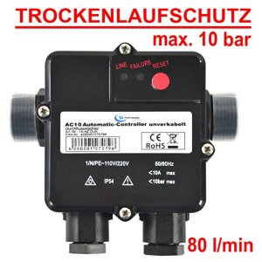
CFG Hooks

Slide 33
What is CFG?
“Whilst compiling and linking code, it analyzes and discovers every location that any indirect-call instruction can reach. It builds that knowledge into the binaries (in extra data structures – the ones mentioned in a dumpbin /loadconfig display). It also injects a check, before every indirect-call in your code, that ensures the target is one of those expected, safe, locations. If that check fails at runtime, the Operating System closes the program.” - Microsoft

Slide 34

Indirect Jump Integrity
When a binary is compiled with CFG, any indirect call now looks like this
At compile time, the guard check function points to:
Which in turn, is just a “ret”
So what changes this to a useful function?
The key lies in the loader…

Slide 35
Image Load Config Directory
Special data structure provided by the linker (with support from the compiler) which was originally used for compatibility/debugging flags
Became relevant again when security mitigations were added:
Contains the security cookie
Contains the array of trusted SEH dispatch routines
When CFG was introduced, the following new fields were added to IMAGE_LOAD_CONFIG_DIRECTORY:
ULONGLONG GuardCFCheckFunctionPointer;
ULONGLONG GuardCFFunctionTable;
ULONGLONG GuardCFFunctionCount;
DWORD GuardFlags;
Bonus: check out GuardCFDispatchFunctionPointer and CodeIntegrity fields in Win 10

Slide 36
Guard CF Checking Function
Based on the pointer that’s stored in GuardCFCheckFunctionPointer, the loader will overwrite this data during load time using LdrpCfgProcessLoadConfig
The protection is changed to PAGE_READWRITE, the pointer is overridden and then the protection is restored back
The pointer is overridden with LdrpValidateUserCallTarget
This only happens if the image is linked with CFG (IMAGE_DLLCHARACTERISTICS_GUARD_CF)
And only if the IMAGE_GUARD_CF_INSTRUMENTED flag is set in GuardFlags
On failure, RtlpHandleInvalidUserCallTarget is used to determine what to do (suppressed address validation)
Results in exception or inhibition of the error

Slide 37
Writing a Guard CF Function
title “CFG Hook"
include ksamd64.inc
subttl "Function to receive CFG Callbacks"
EXTERN CfgCHook:PROC
NESTED_ENTRY CfgHook, TEXT
GENERATE_EXCEPTION_FRAME Rbp ; More crashes
call CfgCHook ; Oh no, what will you call here?
RESTORE_EXCEPTION_STATE Rbp ; None of this works!
ret
NESTED_END CfgHook, TEXT
end

Slide 38
CFG Hooking Demo

Slide 39
CFG Bonus
CFG in Windows 10 covers a lot more that no one has yet talked about
Nirvana Hooks are protected by CFG to avoid using them as a bypass ☺
MmCheckForSafeExecution protects the ATL Thunk emulation to avoid using it as a CFG bypass ☺
RtlGuardIsValidStackPointer is used with “Check Stack Extents” mode
For example, when using NtContinue or SetThreadContext, stack addresses are validated
(Rtl)SetProtectedPolicy/(Rtl)QueryProtectedPolicy are new user-mode APIs to associated protected data with GUIDs
Data is stored in a protected “Mrdata” heap
Only active if CFG is enforced
.mrdata section contains key CFG variables and function pointers

Slide 40
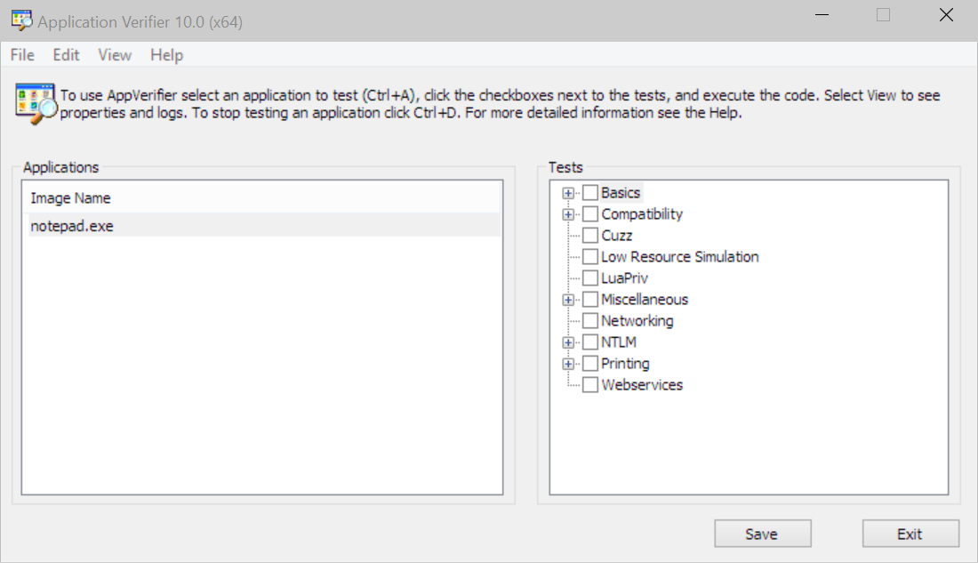
AVRF Hooks

Slide 41
What is Application Verifier
“Application Verifier (AppVerif.exe) is a dynamic verification tool for user-mode applications. This tool monitors application actions while the application runs, subjects the application to a variety of stresses and tests, and generates a report about potential errors in application execution or design. It finds subtle programming errors that might be difficult to detect during standard application testing or driver testing.” –Microsoft

Slide 42
Application Verifier Engine
The Application Verifier engine itself (Verifier.dll) receives a number of interesting pointers to the loader’s internals
Loaded by AvrfMiniLoadDll and receives a pointer to a RTL_VERIFIER_HELPER_TABLE structure
The engine will then interact with Application Verifier Providers that are built on top of it
The Verifier returns back an RTL_VERIFIER_HEAP_TABLE
This allows verifier to hook all Heap APIs, as well as to provide a Query/Set callback
This is used primarily when enabling the “page heap”

Slide 43
Enabling Application Verifier
The App Verifier activates itself when it sees FLG_APPLICATION_VERIFIER or FLG_HEAP_PAGE_ALLOCS present in the Global Flags
Global Flags are the Image File Execution Options (IFEO) that can be set for a given image name
HKLM\Software\Microsoft\Windows NT\CurrentVersion\Image File Execution Options
Set GlobalFlag to “0x100”
As a REG_SZ!
You can customize which Providers to load with the “VerifierDlls” REG_SZ value
Abused by “Trust Fighter” malware as well as EA Anti-Cheating tools
“VerifierFlags” is REG_DWORD value to customize AVRF Settings

Slide 44
Application Verifier Providers
Providers are loaded by the Application Verifier Engine based on either the contents of the “VerifierDlls” key in per-image IFEO key, or by the {ApplicationVerifierGlobalSettings} option in the root IFEO key
If a provider is called “vrfcore.dll” and exports a function called “AVrfAPILookupCallback”, then all GetProcAddress (LdrGetProcedureAddress) function calls will first be directed to it
Callback includes the address of the caller of GetProcAddress, and the ability to redirect the answer to another routine
Other than that, verifier providers can hook any exported function of any DLL they please, by filling out special structures during their entrypoint
You can set AVrfpDebug (from the “VerifierDebug” IFEO value) to see the internals…

Slide 45
Writing a Verifier Provider
This time, we have to write an actual DLL
Those of you that do Win32 programming are certainly aware of DllMain and its four “reasons”
DLL_PROCESS_ATTACH
DLL_PROCESS_DETACH
DLL_THREAD_ATTACH
DLL_THREAD_DETACH
But did you know there’s a fourth?
DLL_PROCESS_VERIFIER
This special reason comes with a pointer to a RTL_VERIFIER_PROFIDER_DESCRIPTION structure
The structure provides input data to the verifier provider, as well as allows it to register a number of thunks for each exported API from one of the DLLs

Slide 46
Verifier Provider Structures
typedef struct _RTL_VERIFIER_PROVIDER_DESCRIPTOR { DWORD Length; PRTL_VERIFIER_DLL_DESCRIPTOR ProviderDlls; RTL_VERIFIER_DLL_LOAD_CALLBACK ProviderDllLoadCallback; RTL_VERIFIER_DLL_UNLOAD_CALLBACK ProviderDllUnloadCallback; PWSTR VerifierImage; DWORD VerifierFlags; DWORD VerifierDebug; PVOID RtlpGetStackTraceAddress; PVOID RtlpDebugPageHeapCreate; PVOID RtlpDebugPageHeapDestroy; RTL_VERIFIER_NTDLLHEAPFREE_CALLBACK ProviderNtdllHeapFreeCallback; } RTL_VERIFIER_PROVIDER_DESCRIPTOR; typedef struct _RTL_VERIFIER_THUNK_DESCRIPTOR { PCHAR ThunkName; PVOID ThunkOldAddress; PVOID ThunkNewAddress; } RTL_VERIFIER_THUNK_DESCRIPTOR; typedef struct _RTL_VERIFIER_DLL_DESCRIPTOR { PWCHAR DllName; DWORD DllFlags; PVOID DllAddress; PRTL_VERIFIER_THUNK_DESCRIPTOR DllThunks; } RTL_VERIFIER_DLL_DESCRIPTOR;

Slide 47
Hooking APIs with Avrf
static RTL_VERIFIER_THUNK_DESCRIPTOR g_Thunks[] = {{"CloseHandle", NULL, (PVOID)(ULONG_PTR)CloseHandleHook}, ...};
static RTL_VERIFIER_DLL_DESCRIPTOR g_HookedDlls[] = {{L"kernel32.dll", 0, NULL, g_Thunks}, ... };
static RTL_VERIFIER_PROVIDER_DESCRIPTOR avrfDescriptor = {sizeof(RTL_VERIFIER_PROVIDER_DESCRIPTOR), g_HookedDlls};
BOOL CloseHandleHook (_In_ HANDLE hObject) { BOOL fRetVal = ((PCLOSE_HANDLE)aThunks[0].ThunkOldAddress))(hObject);
DbgPrintEx(77, 0, "[CloseHandle] Handle: 0x%p = %s\n", hObject, fRetVal ? "Success" : "Failure");
return fRetVal; }

Slide 48
Verifier Provider Demo

Slide 49
Application Verifier Bonus
Because the IFEO key is stored in the “SOFTWARE” hive, only an Administrator user can turn on Verifier and allow these hooks to be applied
Except it turns out that there’s an override in the KUSER_SHARED_DATA
+0x3a0 ImageFileExecutionOptions : Uint4B
This override can be set early at boot by the kernel, based on the following registry modification
HKEY_LOCAL_MACHINE\SYSTEM\CurrentControlSet\Control\Session Manager\ImageExecutionOptions = 1 (REG_DWORD)
Documented here (“VerifierIsPerUserSettingsEnabled”)
https://msdn.microsoft.com/en-us/library/bb432502(v=vs.85).aspx
If this is set to true on your machine, you are vulnerable to hijacks!

Slide 50
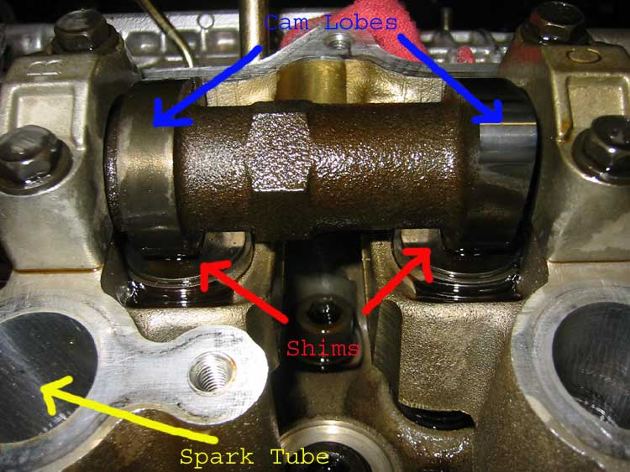
Shim Hooks

Slide 51
What is the Shim Engine
“To reduce deployment costs and accelerate adoption, Microsoft invests in deep technical solutions to ensure broad compatibility of existing software, driving compatibility into the engineering and release process.
The Microsoft Windows Application Compatibility Infrastructure (Shim Infrastructure) is one such powerful technical solution.
The Shim Infrastructure implements a form of application programming interface (API) hooking. Specifically, it leverages the nature of linking to redirect API calls from Windows itself to alternative code—the shim itself. ” – Microsoft

Slide 52
Shim Engine
Loaded by LdrpInitShimEngine – receives a pointer to the name of the DLL that implements the Shim Engine
Pointer comes from PEB->pShimData
LdrpGetShimEngineInterface is then called to retrieve the main pointers
Then, the DLL entrypoint is called
LdrpLoadShimEngine is later used to load all the Shim Engine Plugins
SE_ShimDllLoaded is called for each plugin
Then SE_InstallBeforeInit once plugins are all loaded
Then, SE_DllLoaded for each already-loaded DLL

Slide 53
Enabling the Shim Engine
The Shim Engine activates itself when it sees that the PEB’s pShimData contains a valid pointer
This pointer is actually a Unicode string to the DLL that implements the engine itself
Normally filled out by the creating process after doing a lookup in the Application Compatibility Database
But can be filled out “unofficially” by someone creating the process suspended – and then modifying the PEB

Slide 54
Writing a Shim Engine
As of Windows 8.1, you no longer need to implement all Shim Engine APIs – there is an initial restricted set, and a full set
SE_InitializeEngine
SE_InstallBeforeInit
SE_InstallAfterInit
SE_ShimDllLoaded
SE_DllLoaded
SE_DllUnloaded
SE_LdrEntryRemoved
SE_ProcessDying
SE_LdrResolveDllName
SE_GetProcAddressLoad / SE_GetProcAddressForCaller

Slide 55
Dynamic Shim Installation
Shims can also be dynamically installed with LdrInitShimEngineDynamic
In Windows 7, provide the DLL Base address of your Shim-Engine compatible DLL
In Windows 8 and higher, also provide a UNICODE_STRING with a list of Shim DLLs to load as the second parameter
Separate with NULL, and set MaximumLength to have the full length
Can call multiple times to add new shim plugin DLLs to load, but only one engine can be loaded

Slide 56
Conclusion
Windows has a variety of DLL hijacking/loading functionality built-in
Most of it is accessible through various undocumented flags, structures and mechanisms
It is slowly being secured, in some cases, but other mechanisms are still wide open for attack
These mechanisms not only allow for hijacking, but also persistence, and in some cases emulation defeats (such as the instrumentation callback)
People need to take a deeper look at CFG – not everything has yet been revealed ☺

Slide 57
QUESTIONS?
SEE YOU AT BLACKHAT

